Slide 1
Scalable k-means++
Jeffrey Lehmann, Zachary Nawrocki, and Ziping Song
Pedagogical Course Project
Randomized Algorithms for Machine Learning & Optimization

Slide 2
Agenda
The selected paper
What is k-means?
What is k-means++?
What is k-means|| and how does it work?
Runtime, tradeoff of quality with runtime
Comparing the three algorithms via trials
Notes:
It’s important to go over the foundations, since k-means is part of k-means++, and k-means++ is a part of Scalable k-means++
In order to understand Scalable k-means++, you need to understand k-means++, and in order to understand k-means++, you need to understand k-means

Slide 3
Paper: Scalable K-Means++
Authors
Bahman Bahmani, Stanford University, Stanford, CA
Benjamin Moseley, University of Illinois, Urbana, IL
Andrea Vattani, University of California, San Diego, CA
Ravi Kumar, Yahoo! Research, Sunnyvale, CA
Sergei Vassilvitskii, Yahoo! Research, New York, NY
Date: Thursday, March 29, 2012
Venue: Proceedings of the VLDB Endowment (PVLDB), Vol. 5, No. 7, pp. 622-633 (2012)
Problem Addressed: How to drastically reduce the number of passes needed to obtain, in parallel, a good initialization for the K-means algorithm.

Slide 4
What is k-means? - The Foundations and Motivations
A solution to a problem in unsupervised learning
Unsupervised learning: A preprocessor to organize the data for supervised learning
The problem: clustering
How can we group data points?
Notes:
The motivation behind k-means -
The K-means algorithm is a solution to a common problem in unsupervised learning. Now, unsupervised learning is a little different than what we have done during most of this course.
With unsupervised learning, we are grouping data, that we know nothing about, other than some pattern we have discovered. After grouping this data together, we will be able to apply supervised learning techniques, such as the ones discussed in class.
Additionally, the grouping of data, itself, is useful, in general. For example, when learning a new language as a child, you may be looking for patterns, or if you have a database of unlabeled movies, you may want to organize them somehow.
Now we described K-means as a solution, to a problem. And that problem is clustering. Clustering is a way of grouping the data points.

Slide 5
What do we need to figure out, to cluster data?
How many clusters? - k
What makes a clustering algorithm good?
The points in a cluster should be close to each other.
Each cluster should be far apart.
Efficiency
How are we going to cluster?
Lloyd’s Algorithm
Notes:
In order to group data points, there are things we need to figure out.
The first thing we need to know is how many clusters we need. For the sake of this presentation, and the algorithms, we will refer to this number as k. In the K-means algorithm, we make k clusters.
The second thing we need to figure out is what makes a clustering algorithm good. For a clustering algorithm to be good, the points within a cluster should be close to each other, and at the same time, other clusters of points should be further away. And of course, efficiency. With each of these algorithms, and the eventually the Scalable k-means++ algorithm, we continue to improve the efficiency of clustering the data
The last thing we need to figure out is how we are going to cluster the data. Well, of course we will be using the K-means algorithm, and in the following slides, the K-means++, and Scalable K-means++ methods, however the algorithm that we use for k-means clustering is Lloyd’s algorithm.

Slide 6
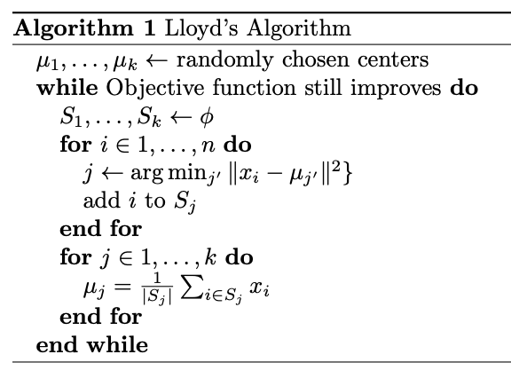
Lloyd’s Algorithm
Source: cs.yale.edu/homes/el327/datamining2013aFiles/10_k_means_clustering.pdf
Notes:
We will describe the algorithm now, and it may be easier to understand with the example, in the following slide. But first, in summary, we start by randomly selecting k points as centers. Again, k is the number of resulting clusters. This is the initialization step in k-means.
Next, we go through each other point, and calculate the distance between the point and the centers. Each point becomes part of the cluster, which’s center is closest. Then, we calculate the mean of each cluster, and repeat the previous process, where the means of each cluster become the centers, and we reassign the other points to the closest cluster.
We keep following this process until the clusters are no longer modified.
It may be a good idea to repeat Lloyd’s algorithm multiple times. There can be more than one way to cluster the data, and the randomization at the beginning can result in different clusters. In the end, you can select the clusters with the least total variance.

Slide 7
k-means Example, k=3
Visually, we have an idea of a clustering.
Notes:
1-D

Slide 8
k-means Example, k=3
For example:

Slide 9
k-means Example, k=3
Now let’s try clustering using Lloyd’s algorithm.
Notes:
1-D

Slide 10
k-means Example, k=3
First, we randomly select k centers. Here, we are using Google’s random number generator.
Notes:
1-D

Slide 11
k-means Example, k=3
Next, we group the data points into k clusters, based on their distances to the centers.

Slide 12
k-means Example, k=3
Then we calculate the mean of each cluster, make it the center, and recluster.

Slide 13
k-means Example, k=3
The clusters were modified, so we repeat the process. Here are the new means and clusters.

Slide 14
k-means Example, k=3
In this iteration, however, no updates were made. Therefore, we are done with the algorithm.

Slide 15
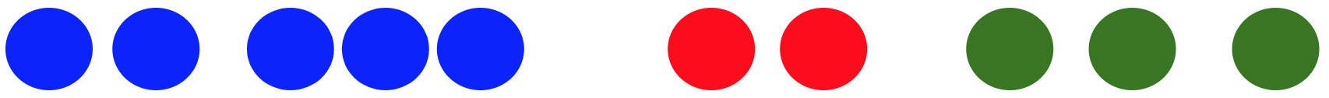
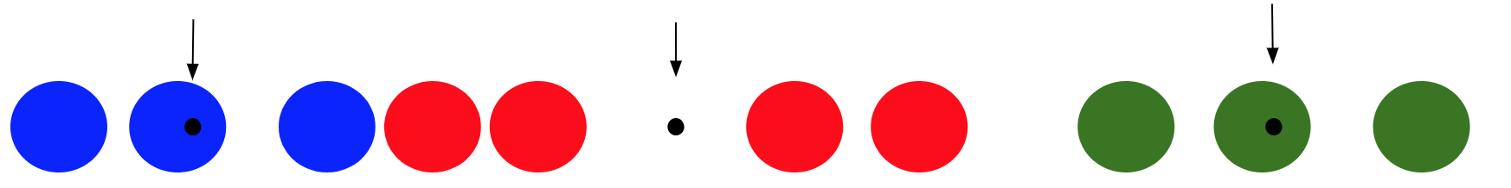
The Problems with k-means
Different (and worse) clusterings can result, as seen in the previous example.
Due to randomization, it is likely that we initialize multiple centers in the same cluster.
It can take a while to converge, especially with large datasets.
Lloyd’s Algorithm is NP-hard
Assuming fixed dimensions, the runtime is O(nkdi), where n is the number of vectors of dimension d, k is the number of clusters, and i is the number of iterations until convergence.
What would a better algorithm accomplish?

Slide 16
An improvement on k-means: k-means++
What does it do?
Clusters points based off distance to all current clusters
Points are chosen with probabilities proportional to their distances from other centers
Guarantees clusters are far away
Is this better than Lloyd’s algorithm?
Significantly more accurate
Scales better than Lloyd’s (but still not scalable)
O(nkd) initialization
Notes:
An improvement on the k-means algorithm is k-means++. K-means++ looks to improve the runtime of lloyd’s algorithm by picking smarter centers, thus making k-means++ an initialization algorithm for the k centers. So what does k-means++ do to improve runtime? It picks centers based off distance to other clusters which ensures that centers are guaranteed to be far away, which should lead to more accurate clusters. Of course the question then becomes is it actually better than Lloyd’s algorithm with random initialization, and the answer is yes. As we have already discussed the way k-means++ picks centers makes the clustering more accurate and the more accurate clusters leads to a lower number of Lloyd iterations to converge. Something we will want to keep in mind is that the runtime is linear with n, k, and d.

Slide 17
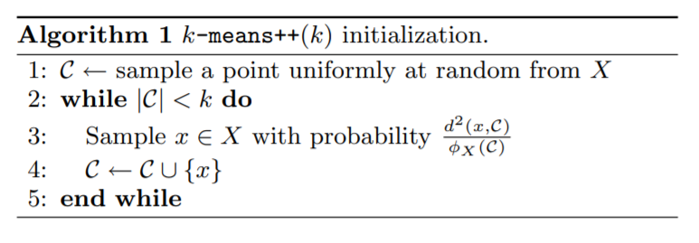
K-means++ Initialization Algorithm
Notes:
This is the official k-means++ algorithm which shows formally how each iteration is performed. First we pick a random center uniformly at random from the distribution and then start choosing centers. The while loop will pick k centers in store those centers in C, picking one center at each iteration where each point in the dataset has a probability of it being chosen proportional to the sum of the distances squared(squared so we dont have to work with square roots) between the current centers and that point. Once we have selected k centers, then k-means++ has finished and those centers can be used for Lloyd iterations to cluster points together.

Slide 18
K-means++ example, k = 4
Now let’s try clustering in two dimensions
Notes:
Now just to clarify the algorithm we will run through an example and in this example we will try picking 4 centers in two dimensions.

Slide 19
K-means++ example, k = 4
Potential clustering of the data
Notes:
Here is what an optimal clustering for the data would look like

Slide 20
K-means++ example, k = 4
K-means++ starts by picking a random center, then calculates distances
Notes:
So, we start with step 1 of the algorithm which is picking a random center and calculating the distances squared to all other points

Slide 21
K-means++ example, k = 4
Then it picks another center with probability proportional to distance
Most likely point to be selected
Notes:
Then we pick a point proportional to the distance away from the original center, and know we have our second center

Slide 22
K-means++ example, k = 4
Recalculates distances, and picks new center
Notes:
Then we calculate the sum of the distances squared between those 2 points and all other points and pick a new center.

Slide 23
K-means++ example, k = 4
Recalculates the distances to all points from these 3 centers, then picks 4th center
Notes:
We do this step again until now we have our 4 centers.

Slide 24
K-means++ example, k = 4
Now that we have k centers we calculate the distance from each point to each center and assign points to cluster with their nearest center.
Notes:
Now that k-means++ is over we can see how a Lloyd iteration would group these elements to their nearest center and we continue to do Lloyd iterations until convergence.

Slide 25
K-means++ example, k = 4
Now clustering has finished!
Notes:
And here we have the final clustering

Slide 26
Problems with k-means++
K-means++ needs to pass over the data k times
Picks only one center at each iteration
K-means++ is sensitive to outliers
Outliers have higher probability of being chosen
How can we fix these problems?
Possible second center
Most likely third center
Possible first center
Notes:
So we explained what some of the benefits of k-means++ are, but what are some of the problems? In k-means++ we pick one center at each iteration which means we have to iterate k times, calculate the distances squared and updating the probability distribution at each iteration, which is quite expensive. Not only is the runtime expensive, but k-means++ is also sensitive to outliers because the most likely point to be picked at each iteration is an outlier because outliers are inherently far from the rest of the distribution. So we have two problems, runtime and accuracy, how can we fix these problems?

Slide 27

The fix: Scalable k-means, or k-means||
Essential changes:
Oversampling factor l
l determines the number of points we pick in each round
(log ψ) iterations
Depends on the clustering time of the first initialization
(log ψ) << k
O(ndlog(ψ)) initialization
Notes:
Rather than picking a point and updating the probability distribution based off the new distances, k-means parallel picks multiple new centers, which is referred to as l in this paper. It then updates the probability distribution based off those new new centers and picks another set of multiple centers until it does R iterations. After it has done R iterations, it then clusters the centers that were chosen, in say set C, using K-means++. (R is ψ, the initial cost of the clustering after the first selection center is chosen)

Slide 28
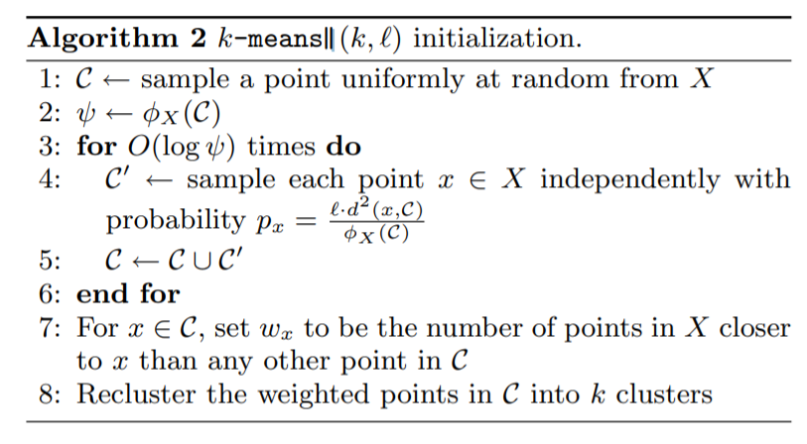
K-means|| algorithm

Slide 29
K-means|| example, k = 4, l = 3
Let’s use a familiar example to show the difference between k-means|| and k-means++.

Slide 30
K-means|| example, k = 4, l = 3
Similar to k-means++, k-means|| randomly selects the first center uniformly at random.

Slide 31
K-means|| example, k = 4 l = 3
Next we compute the distances to all other points and save the cost of this computation in ψ, which determines the number of iterations we perform.
Note: ψ ≤ n²d²

Slide 32
K-means|| example, k = 4, l = 3
Now we do not pick 1 new center (as k-means++ would), but we rather pick l points, in this case 3, with probability proportional to distance.

Slide 33
K-means|| example, k = 4, l = 3
Then we compute the distances between all points and these centers. K-means++ would stop here but k-means|| will often calculate more than k centers.
Set C

Slide 34
K-means|| example, k = 4, l = 3
So now we pick l more centers and we repeat the process until we have iterated log(ψ) times.

Slide 35
K-means|| example, k = 4, l = 3
Let’s say log(ψ) = 2 and that we are done picking centers, we know evaluate the set C containing the 7 selected centers and recluster those to get k centers.

Slide 36
K-means|| example, k = 4, l = 3
We can use Lloyd’s algorithm or k-means++ to recluster the 7 centers and get these clusters.
Notes:
Technically looks at all the centers in C and creates new weighted points based off the number of points closest to each center.

Slide 37
Differences
K-means++ | K-means||
K iterations over the dataset | log(ψ) iterations where ψ ≤ n²d², scales well
Adds one center per iteration | Adds multiple centers (l centers) per iteration
Calculates exactly k centers | Calculates more than k centers due to oversampling of the data
These runtime differences are nice but with so few iterations being run, can we expect accurate results?
Notes:
K-means++ is slower than k-means|| because of the R iterations that k-means|| performs, k-means++ runs k iterations because it only adds one center at a time, but k-means|| adds l centers at a time. The oversampling factor allows k-means|| to reach the k number of centers (or even more) much faster, meaning it does not have to iterate nearly as much with each iteration passing over the whole data set to calculate distances. Runtime of k-means++ is O(nkd), runtime of k-means|| is O(nlog(psi)d)
What does this mean? “There is an additional technicality that we must be cognizant of: whereas k-means++ draws a single center from the joint distribution induced by D 2 weighting, k-means|| selects each point independently with probability proportional to D 2 , selecting ` points in expectation” (Page 7, section 5.3)

Slide 38
To Do
According to https://www.cs.rpi.edu/~gittea/teaching/fall2020/project.html
What is the main result of the paper?
Describe the result or algorithm and motivate it intuitively.
What is the cost (time, space, or some other metric) of this algorithm, and how does it compare to prior algorithms for the same problem? (and similarly, for non-algorithmic results)
What performance guarantees, if any, are provided for the algorithm?
Give an accurate description of the analysis given in the paper: in simple cases this may be a tour through the entire argument; when this is not possible, focus on explaining a core lemma/theorem that supports the claim of the paper.
Provide an empirical evaluation of the algorithm: compare its performance to reasonable baselines, and explore relevant aspects of the algorithm (its variability, sensitivity to relevant properties of the input, etc.). If presenting a non-algorithmic result and it is possible, provide some experimental evidence of its sharpness or lack thereof.

Slide 39
Experiments
Letter recognition dataset with k = 26 and 16 dimension:
 | Average cluster cost | Cluster cost variance | Runtime (second)
K-means (randam initilization) | 0.2928 | 0.001418 | 9.4647
Kmeans ++ | 0.2393 | 0.0003869 | 8.4410
Scalable k-means++ with parallel (simulate 16 core cpu) | 0.2347 | 0.0001386 | 6.7902

Slide 40
Experiments
Synthetic Gaussian dataset with k = 16 and 2 dimension:
 | Average cluster cost | Cluster cost variance | Runtime (second)
K-means (randam initilization) | 12831 | 9348880 | 2.8248
Kmeans ++ | 1311 | 90518 | 2.0286
Scalable k-means++ with parallel (simulate 16 core cpu) | 1862 | 247613 | 1.9778

Slide 41
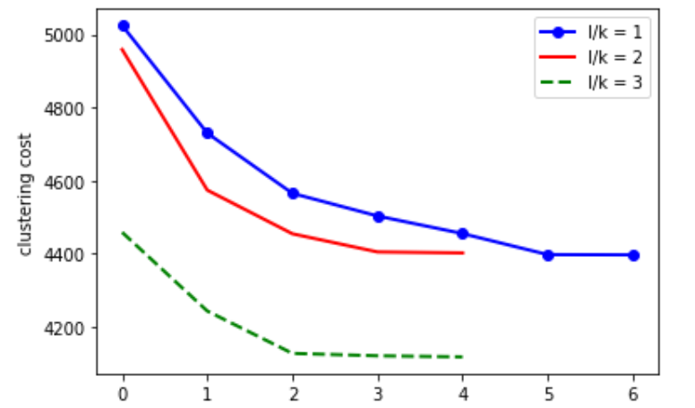
Experiment

Slide 42
Conclusion/Big Picture
K-means|| and k-means++ are accurate
Both find centroids that are better than random initialization
The selected centers are much less likely to be part of the same cluster
K-means|| scales well with its few iterations
Scales down the number of iterations on large data sets (i.e., n > 10⁹) to be magnitudes smaller than k-means++
By decreasing the size of the data, through distribution, problems can be solved more quickly
K-means|| is applicable in many real-world unsupervised learning situations.
Whether it’s credit fraud detection, organizing featureless data (or data with very few features), or any sort of data analysis, k-means|| can be a useful way for preprocessing the data for supervised learning.

Slide 43
Sources
Bahmani, Moseley, Vattani, Kumar, Vassilvitskii, Scalable K-Means++, arXiv:1203.6402 [cs.DB] -- The paper that inspired this presentation
Professor Alex Gittens, CSCI 4961, Machine Learning & Optimization Lectures, Rensselaer Polytechnic Institute
Professor Malik Magdon-Ismail, CSCI 4100, Machine Learning from Data Lectures, Rensselaer Polytechnic Institute
Seif, The 5 Clustering Algorithms Data Scientists Need to Know, Towards Data Science
Professor Edo Liberty, Lecture 10: k-means clustering, Algorithms in Data Mining, Yale University
Arthur, Vassilvitskii, K-means++: The Advantages of Careful Seeding, SODA ‘07

